Slide 1
QF602: Derivatives
Lecture 2: Options

Slide 2
Option Contract
Call option confers right (but not obligation) for holder (or long party) to buy underlying asset from writer (or short party)
Put option confers right (but not obligation) for holder (or long party) to sell underlying asset to writer (or short party)
Long party makes upfront payment of option premium (or price or value) to short party

Slide 3
Option Contract
Transaction occurs when option is exercised, at ﬁxed exercise price (or strike price)
Option expires if not exercised before date of expiration (or maturity)

Slide 4
Option Contract
European-style option may only exercised on date of expiration
American-style option may be exercised at any
time up to date of expiration
Bermudan-style option may be exercised at ﬁxed times up to day of expiration (i.e., half way between European and American!)

Slide 5
Option Contract
Option may be exchange-traded or OTC
Exchange-traded options tend to be more standardized and liquid then OTC options
Long party may be exposed to default risk for OTC options (but not short party)

Slide 6
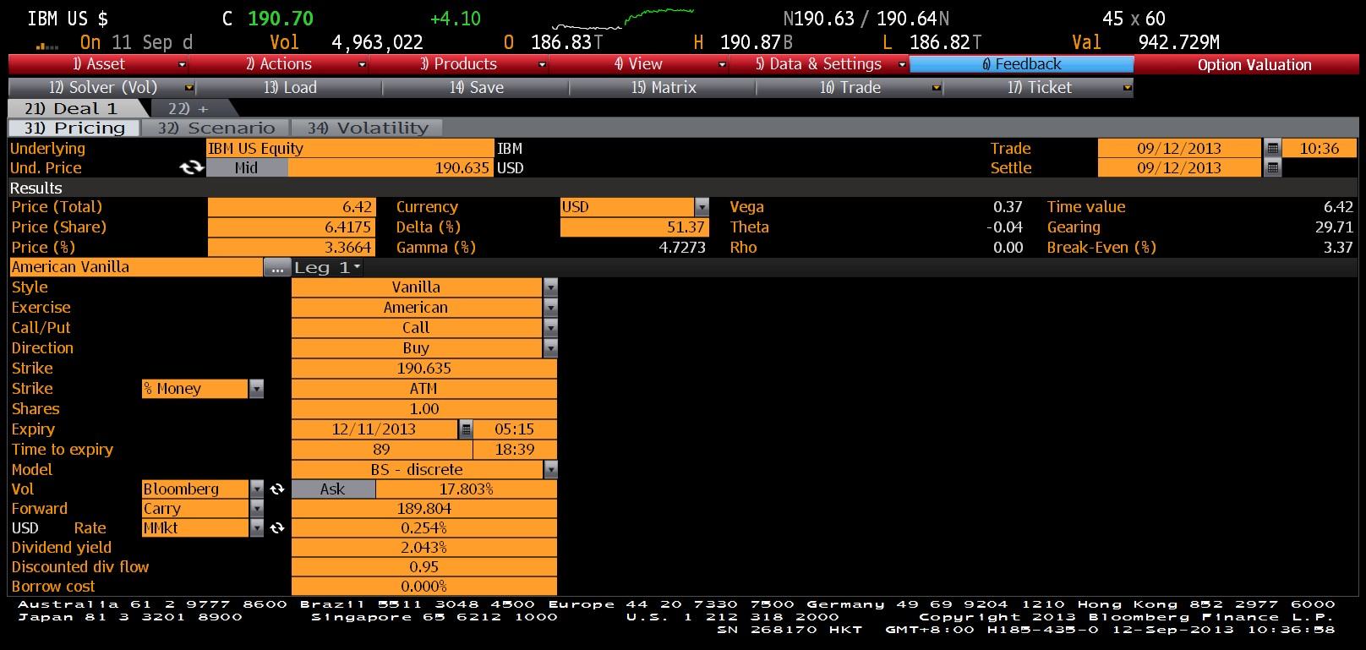
Example: Option on IBM
I

Slide 7
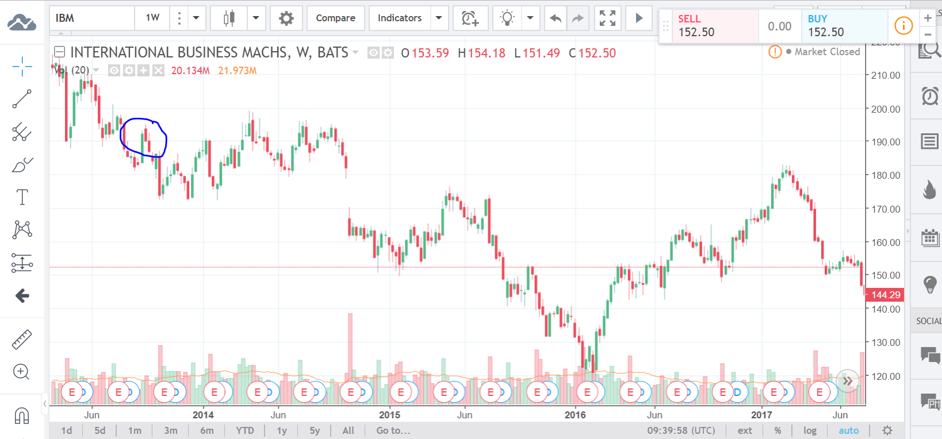
IBM stock prices

Slide 8
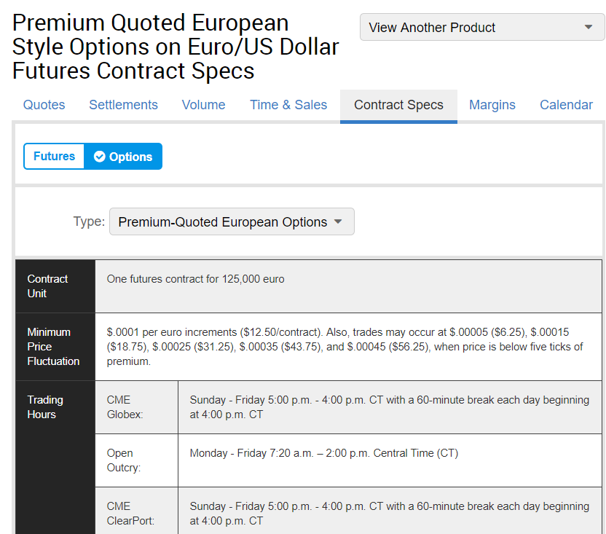
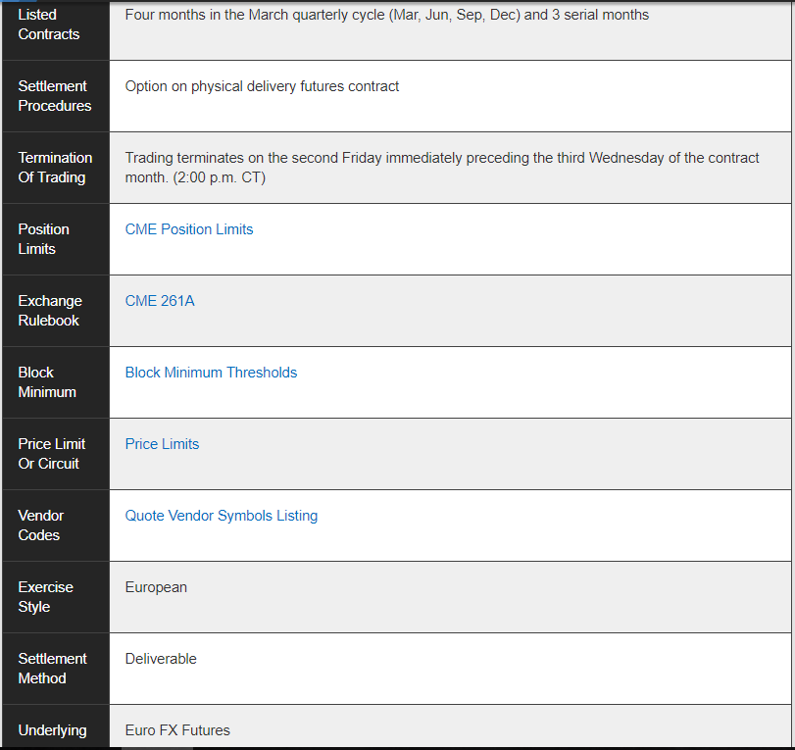
Exchange-Traded Option

Slide 9
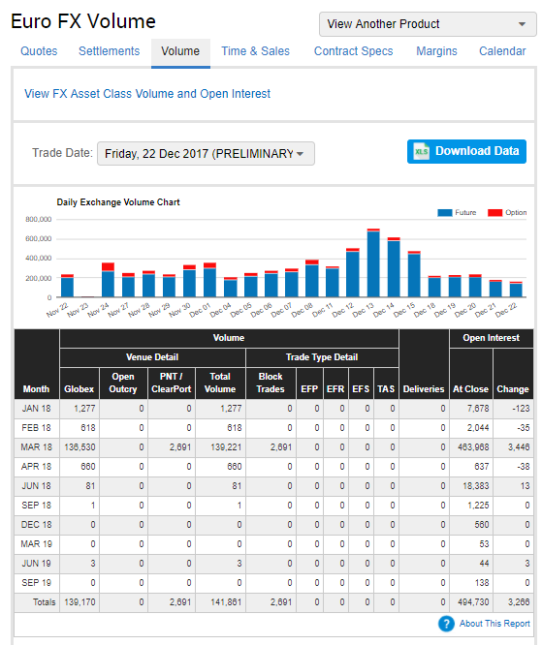
EURUSD FX Futures

Slide 10
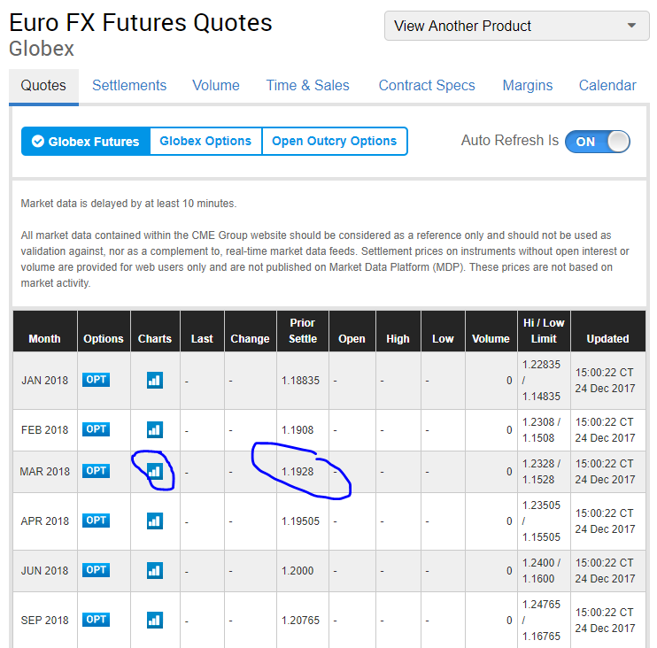
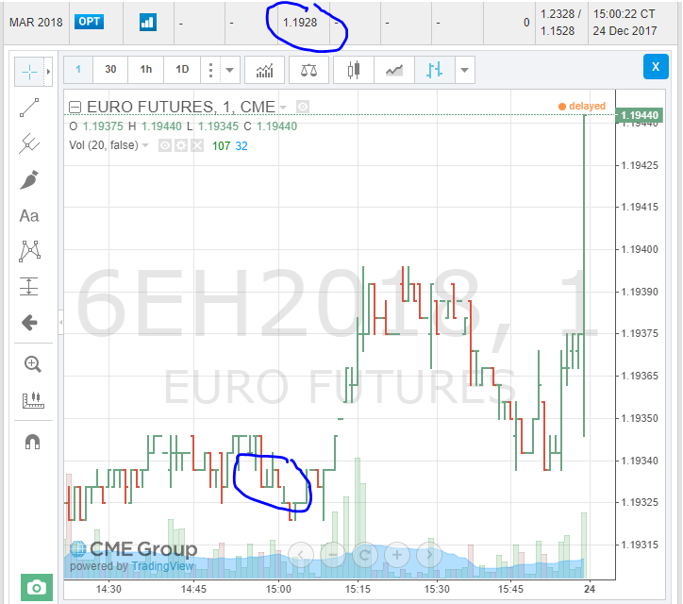
EURUSD FX Futures

Slide 11
Moneyness
Let S(t) be spot price of underlying asset at time t
Let K be exercise price
Option is in-the-money when exercise is proﬁtable: S(t) > K for call and S(t) < K for put
Option is out-of-the-money when exercise is not proﬁtable: S(t) < K for call and S(t) > K for put
Option is at-the-money when S(t) = K

Slide 12
Moneyness
Note that this is not the only definition of moneyness.
Moneyness can be set with respective to forward in some market like rates option.
For FX option, ATM strike is the strike such that a straddle has no delta. See chapter 3.5 in Foreign Exchange Option Pricing: A Practitioner's Guide by Clark.

Slide 13
Option Value
Option Value = Intrinsic Value + Time Value
Intrinsic value is payoﬀ from immediate exercise: max(S(t) – K, 0) for call option and max(K – S(t), 0) for put option
Time value is value of not exercising, since intrinsic value may increase if we don’t exercise.

Slide 14




Option Value
Call Option
Put Option
Option Value
Time Value
0
S(t)
0
S(t)
K
K
Intrinsic Value

Slide 15
Put–Call Parity
Let c(t) and p(t) be value of European call and put, respectively, with same underlying, exercise price, and maturity T
Combination of long call and short put at the same strike delivers same payoﬀ as long forward contract
If no cash ﬂows for underlying asset, then no- arbitrage relation for put–call parity:
c(t) − p(t) = (F(t,T) − K) * DF(T-t)

Slide 16
Put–Call Parity
Long Call + Short Put = Long Forward (with forward price = exercise price)
Long Call
Long Forward
0
S_{T}
K
Short Put
c(t) – p(t) = (F(t,T) – K) * DF(T-t)

Slide 17
Put–Call Parity
Rearrange to get diﬀerent interpretation: c(t) + K * DF(T-t) = p(t) + F(t,T) * DF(T-t)
Left side represents a portfolio A, where enough money is deposited into interest- bearing account to cover exercise of call
Right side represents a portfolio B, where put provides protection against drop in value of underlying asset

Slide 18
Example: Put–Call Parity
Call price: $7.50
Put price: $4.25
Exercise price: $100
Underlying price: $99
Time to maturity: 6 months
Risk-free interest rate: 10% p.a., DF(6m) = 0.9512
Forward price = $99 / 0.9512 = $104.08
Dividend yield and repo rate = 0

Slide 19
Example: Put–Call Parity
Value of portfolio A:
$7.50 + $100 * 0.9512 = $102.62
Value of portfolio B:
$4.25 + $104.08 * 0.9512 = $103.25
B is worth more than A, so arbitrage opportunity exists
Buy low, sell high: short B and buy A for immediate proﬁt of 63¢

Slide 20
American option
European option can only be exercised at the maturity.
American option can be exercised at any time before the maturity.
Let c(t), p(t) be European call and put and C(t) and P(t) be American call and put.
It is obvious that C(t) >= c(t) and P(t) >= p(t) if all other terms are the same.
Is there a situation that the C(t) = c(t) and P(t) = p(t)?

Slide 21
American option
Without dividends, never exercise an American call early.
Exercise early requires paying the exercise price early, hence loses the time value of money because he doesn’t receive interest on this cash amount.
On the other hand, he would receive future dividends for holding the stock.
If dividend yield is higher than the interest rate until maturity then it is optimal to exercise.

Slide 22
American option
Without dividends, it can be optimal to exercise an American put early.
Consider a put with K = 100 on a stock with S(t) = 0.
S(t) cannot go any lower and this is the max one can earn for holding a put option.
Exercise now gives $100 today.
Exercise later gives $100 later.

Slide 23
Black Scholes Merton
Key assumptions:
Volatility is constant over time.
Underlying is traded continuously and is log-normally distributed.
One can always short sell.
No transaction costs.
One can sell any fraction of a share.
One can borrow and lend cash at a constant risk free rate.
Stock pays a constant dividend yield.

Slide 24
Risk neutral pricing
The fundamental assumption behind risk-neutral pricing is to use a replicating portfolio of assets with known prices to remove any risk.
In BSM world, options are considered to be redundant in the sense that one can replicate the payoff of an European option on stock using the stock itself and risk-free bonds.
Since options can be replicated and their theoretical values do not depend upon investors’ risk preferences.
The idea of replication is one of the most important contributions by Black, Scholes and Merton.

Slide 25
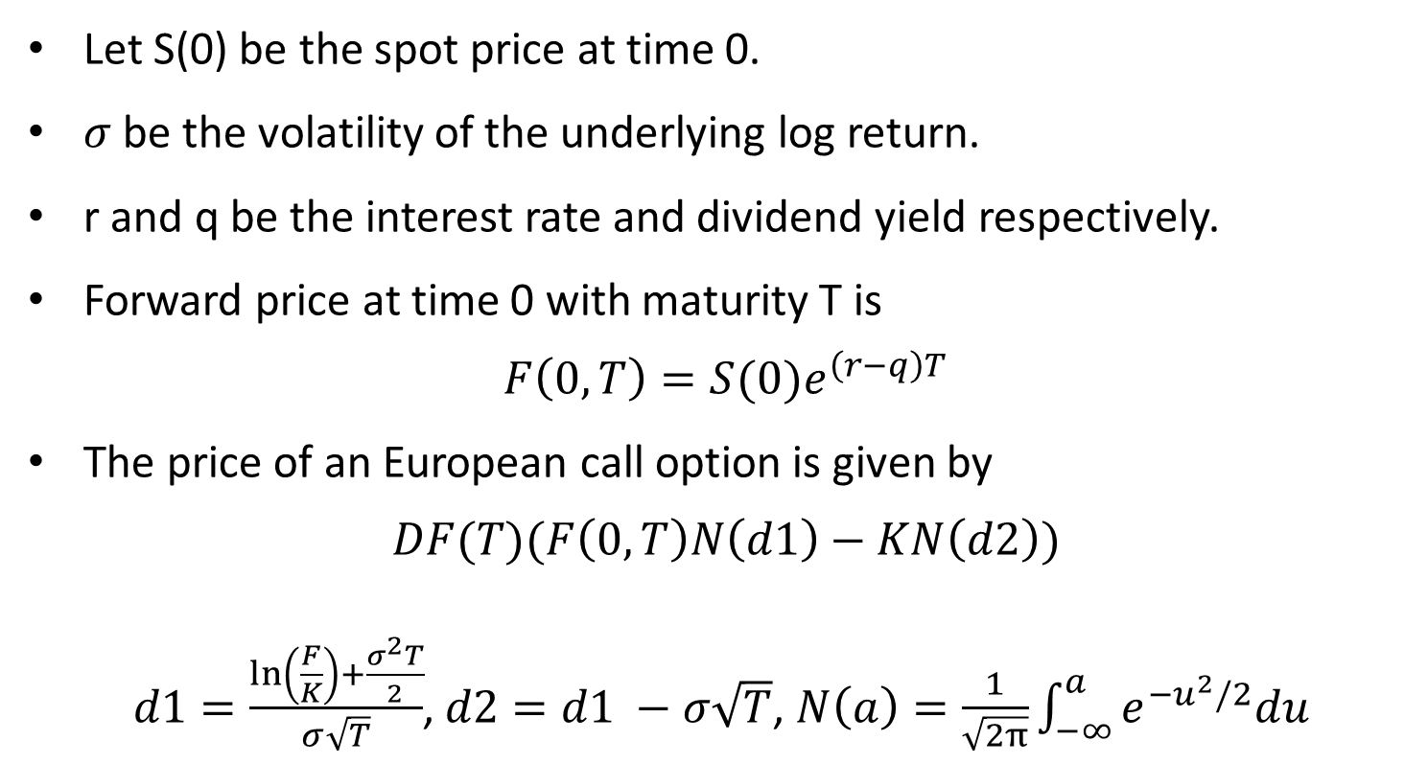
Black Scholes Formula
Let S(0) be the spot price at time 0.
$σ$ be the volatility of the underlying log return.
r and q be the interest rate and dividend yield respectively.
Forward price at time 0 with maturity T is
$$F\left(0,T\right)=S(0)e^{\left(r−q\right)T}$$
The price of an European call option is given by
$$DF(T)(F\left(0,T\right)N\left(d1\right)−KN\left(d2\right))$$
$d1=\frac{\ln\left(\frac{F}{K}\right)+\frac{σ^{2}T}{2}}{σ\sqrt{T}}$, $d2=d1 −σ\sqrt{T}$, $N\left(a\right)=\frac{1}{\sqrt{2π}}\int_{−∞}^{a}{e^{−u^{2}/2}du}$

Slide 26
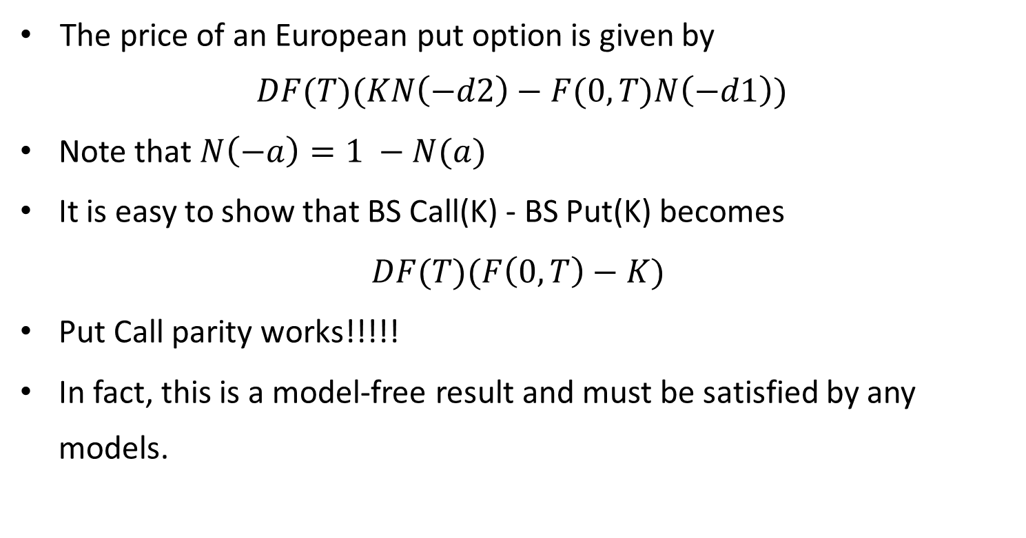
Black Scholes Formula
The price of an European put option is given by
$$DF(T)(KN\left(−d2\right)−F(0,T)N\left(−d1\right))$$
Note that$N\left(−a\right)=1 −N(a)$
It is easy to show that BS Call(K) - BS Put(K) becomes
$DF(T)(F\left(0,T\right)−K)$
Put Call parity works!!!!!
In fact, this is a model-free result and must be satisfied by any models.

Slide 27
Black Scholes Formula
We briefly introduce “Greeks” in this lecture and will come back in more details later.
Call option price is a function of:
Spot
Interest rate
Dividend yield
Time to maturity
Volatility
Their sensitivities can be computed analytically in the BS model.

Slide 28
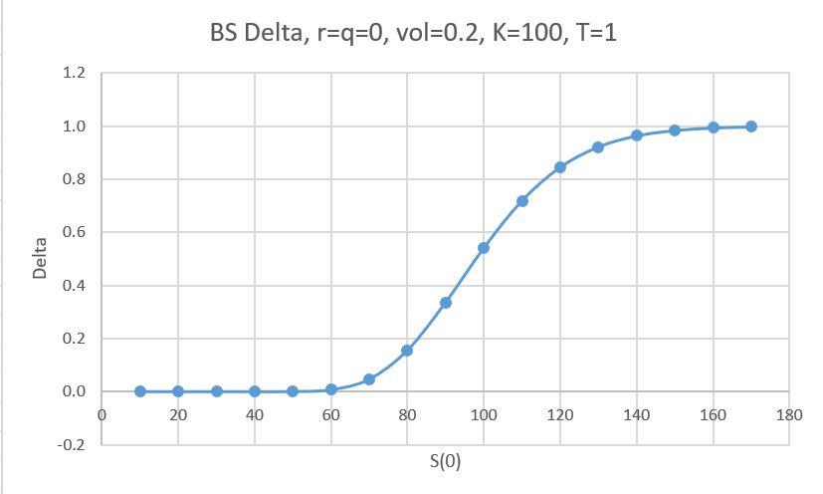
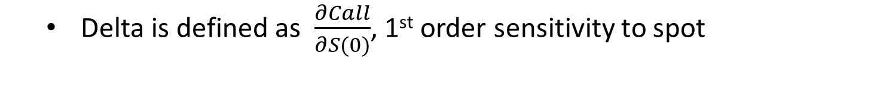
Black Scholes Formula
Delta is defined as $\frac{∂Call}{∂S(0)}$, 1st order sensitivity to spot

Slide 29
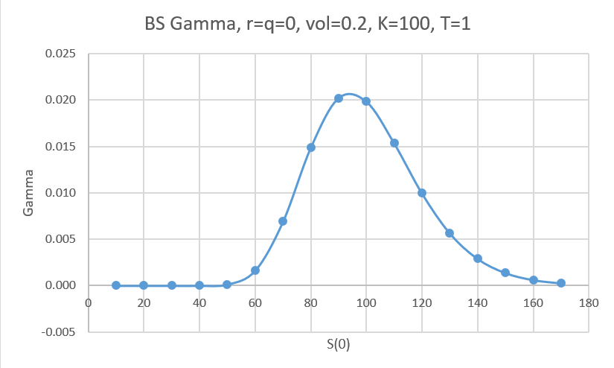
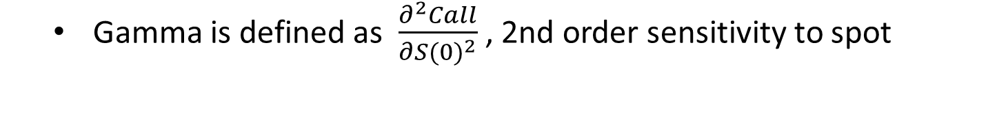
Black Scholes Formula
Gamma is defined as $\frac{∂^{2}Call}{∂{S(0)}^{2}}$ , 2nd order sensitivity to spot

Slide 30
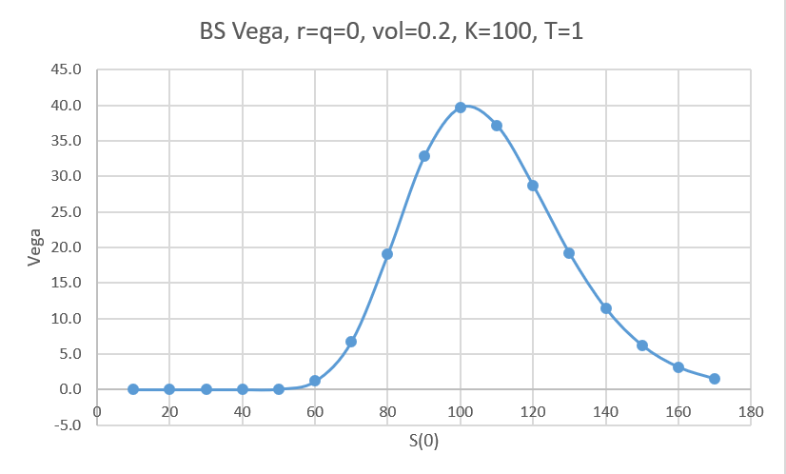
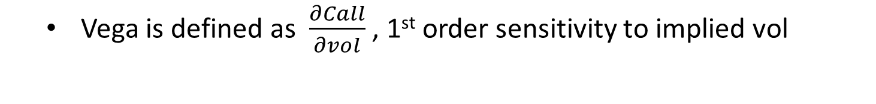
Black Scholes Formula
Vega is defined as $\frac{∂Call}{∂vol}$ , 1st order sensitivity to implied vol

Slide 31
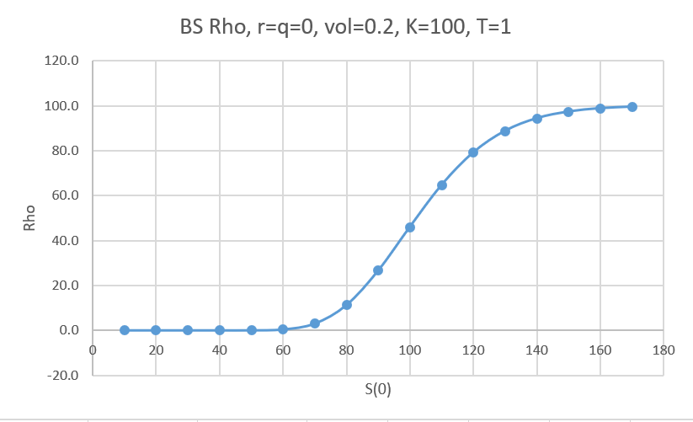
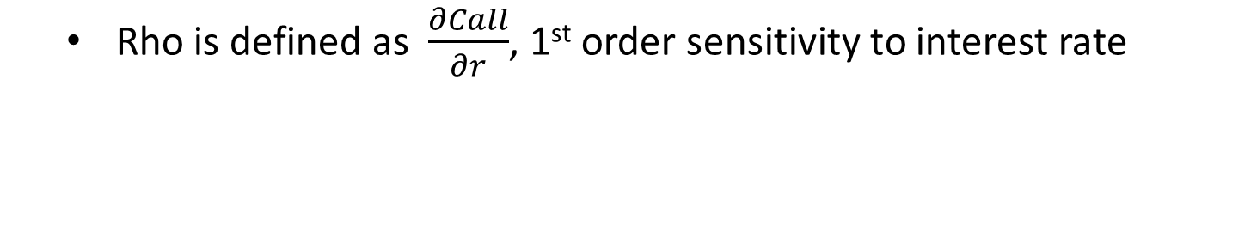
Black Scholes Formula
Rho is defined as $\frac{∂Call}{∂r}$, 1st order sensitivity to interest rate

Slide 32
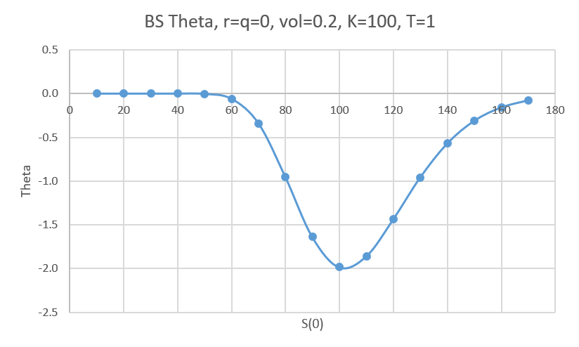
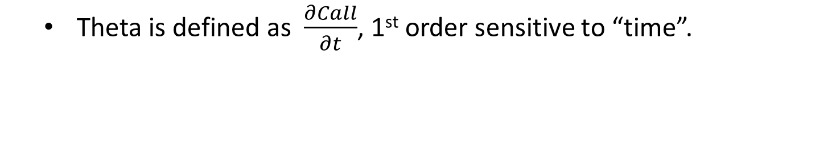
Black Scholes Formula
Theta is defined as $\frac{∂Call}{∂t}$, 1st order sensitive to “time”.

